Slide 1
Peter Francisco Soil & Water Conservation District

Slide 2
What is a soil and water conservation district?
Soil and Water Conservation Districts were created during the Dust Bowl of the 1930's to solve soil and water conservation needs.
The Peter Francisco Soil and Water Conservation District (Peter Francisco SWCD) is a political subdivision of the Commonwealth of Virginia and is responsible under State Law for soil and water conservation work within the boundaries of Buckingham and Cumberland Counties. The District’s purpose is to encourage and initiate land use practices that help improve water quality and reduce soil erosion as well as educate the community in protecting our natural resources.

Slide 3
Why is it important to conserve soil and water?
All the water in the world demo
The Earth as an apple demo

Slide 4
SOL- Related Educational Programs for Middle and High School
The District offers free programs and has compiled a list of programs by grade together with the SOL that the program addresses.
Each program has a hands-on component and is designed to make learning fun.
Here are a few of my favorites:

Slide 5
Hidden Life of Soils
The biorama is displayed and students learn interesting facts about soil, plants, animals, insects and other organisms in the community and their dependency on each other. Life cycles of the insects are discussed as well.
Highlight the carion beetle..
Organisms in soil are discussed, classified and their relationships in the food web explained.
Students play a Go-fish style card game which will familiarize them with different families of life under the soil
SOL: LS.1, LS.4, LS.6, LS.8, BIO.8

Slide 6
Middle and High School Soil Studies
Students learn interesting facts about soil and visit 5 stations for hands-on experience
Station 1 – Soil Textural Triangle
Station 2 – Horizon boxes (pea gravel, clay, sand, fine mulch, potting soil, compost, manure and topsoil are used to create layers in a horizon box. A cup of water with green food color in it is poured in the top and students make predictions about how the water will move through the different layers.

Slide 7
Middle and High School Soil Studies

Slide 8
High School Soils
Station 3 – Soil Textures. Students use the USDA soil texturing field flow chart to identify types of soils based on their ribbon forming ability
Station 4 – Students test soil for temperature, nitrogen, pH, potassium and phosphorus (SOL PS.1, PS.2 and PS.7)
Station 5 – Core sample – students observe a core sample and determine depth of each horizon and use the Munsell Color Chart book to determine the color of each soil horizon.
SOL ES.8

Slide 9
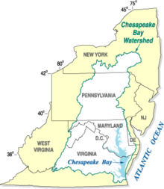
Meaningful Watershed Educational Experience
The Chesapeake Bay Program is the regional partnership that directs and conducts the restoration of the Chesapeake Bay, the largest estuary in the United States. Members of the program include various state, federal, academic and local organizations.
These states are part of the Chesapeake Bay Watershed:
New York, Pennsylvania, Maryland, Delaware and Virginia

Slide 10
Meaningful Watershed Educational Experience
The Governor’s from these 5 states sign agreements committing to follow a unified plan for the Bay’s restoration.
Part of the agreement which the Governor’s signed mandates a Meaningful Watershed Educational Experience in elementary school, middle school and high school.
A MWEE or Meaningful Watershed Educational Experience is an investigative or experimental project that engages students in thinking critically about the Bay watershed. ... Students participate in background research, hands-on activities and reflection periods that are appropriate for their ages and grade levels.

Slide 11
Meaningful Watershed Educational Experience
The District provides watershed education to all grade levels, but teams up with Cooperative Extension and State Parks to provide a Meaningful Watershed Educational Experience to 6th Graders.
We have worked the past couple of years with Mrs. Diane Wiesner, 6th grade science teacher, to provide a field day at Bear Creek Lake State Park
Stations include macroinvertebrate study, chemical and physical water quality monitoring, watershed address and enviroscape demonstration, fish shocking, erosion study/hike.

Slide 12
Meaningful Watershed Educational Experience
Students come up with investigative questions prior to the experience
Then they write a reflective essay after the experience.
This year the District was able to sponsor a MWEE Part 2, called Watershed Exploration Camp. We teamed up with Cooperative Extension for both Buckingham and Cumberland Counties and selected 12 MWEE reflective essays from each county. Their authors were given a full scholarship to Watershed Exploration Camp

Slide 13
Watershed Exploration Camp May 30 – June 1, 2017
Day one was a trip to Virginia Beach where students explored the Atlantic Ocean. That evening we did a lock-in at a local church
Day two was a field trip to the Brock Environmental Center where we toured the center, explored marshlands, boarded a 40-foot boat and explored the Lynnhaven River and Chesapeake Bay. We trawled for fish, pulled up crab and eel pots, performed water quality monitoring and thoroughly enjoyed being on the water

Slide 14
Watershed Exploration Camp May 30 – June 1, 2017
That evening we headed to Hopewell and boarded a pontoon boat piloted by the James River Association. The sun was setting as we cruised the Middle James River on our way to Presquile National Wildlife Refuge (a man-made island) where we spent the night in the bunkhouse.
The following morning we explored the island and its wetlands by foot and then by canoe observing plants and wildlife.
Here is a video prepared by Buckingham Cooperative Experience

Slide 15
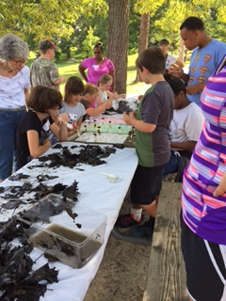
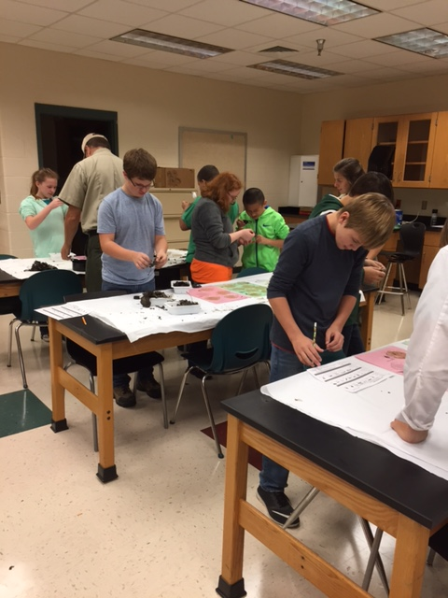
Macroinvertebrate Study

Slide 16
Macroinvertebrates
Leaf litter is collected and observation can be done in the classroom or off-campus like a state park.
Students use little brushes and spoons to collect macroinvertebrate specimens and put them in petri dishes for identification.
The different specimens are tallied and students use this information to determine if the water quality is potentially excellent, good, fair or poor based on their biological assessment.
SOL: Science 6.7, LS.1, LS.4, LS.6, LS.8, BIO 8

Slide 17
What in the World is a Watershed?
Using a map of the county, students learn the watershed address for their school
The enviroscape, a portable 3-D Model provides a hands-on, interactive demonstration of the sources and effects of water pollution.
SOL: Science 6.5 and 6.7

Slide 18
Virtual Watershed Tour

Slide 19
Virtual Watershed Tour
Students divide into four groups and are given a binder with descriptions of 4 different sites in a watershed.
They are given water samples and perform water quality tests on the sample to determine which of the 4 sites within the watershed their sample came from.
Show binder

Slide 20
Physical and Chemical Water Quality Testing
Students will use chemicals and lab equipment to perform water quality tests
- Turbidity - Temperature
- pH - Alkalinity
- Dissolved oxygen - Nitrogen
- Phosphorus - E-coli
SOL: Science 6.7g, LS.1, LS.6, LS.8, LS.9, LS.12, PS.1, PS.2, PS.7, BIO .2

Slide 21
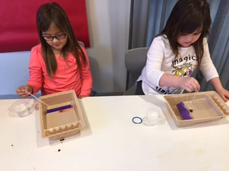
Erosion Experiments
Sediments are the number 1 pollutant in our waterways (soil shake)
Experiments using skittles are performed demonstrating weathering and erosion

Slide 22
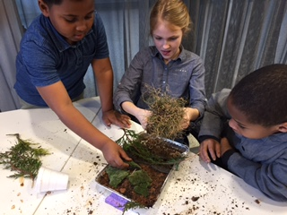
Erosion Experiments
An erosion demonstration using bare soil is given
Then students are divided into groups of “landscape crews”. Their assignment is to use rocks, pine straw, sod, plants, etc. to landscape a bare soil tray to prevent erosion.

Slide 23
Erosion Experiments
We make it rain using a Styrofoam cup with holes punched in the bottom of it over the newly landscaped tray to see how well each landscape crew did in preventing erosion
Students are paid using leftover skittles from the first experiment

Slide 24
Rocks and Minerals – Rock Cycle
Fascinating facts about rocks and minerals are discussed. Students view trays of igneous, metamorphic and sedimentary rocks
Students divide into groups and are given a mineral and a test kit and have to identify their mineral.
Then students play a rock cycle game where they role a die to determine which of 11 stations they go to on their journey as a rock. At each station they collect a bead and end up making a bracelet.
SOL: ES.4 and ES.5

Slide 25
Poster Contest
Each year the National Association of Conservation District has a theme. The theme for 2017 is “Healthy Soils are Full of Life”
Did you know that in a handful of healthy soil, there are more living organisms than there are human beings on planet earth? Most of these organisms are bacteria which help keep soil’s pH in balance. We use soil bacteria to make antibiotics, anti-depressants, anti-fungal and anti-cancer medicines.

Slide 26
Poster Contest
There are 5 categories for the contest: K-1, 2-3, 4-6, 7-9 and 10-12
The District will award a $75 gift card to first place winners, $50 to second place winners and $25 for third place winners in each category.
Posters are due October 2, 2017
Healthy Soils are Full of Life must be written somewhere on the poster and an entry form must be attached to the back of the poster. (Hand out entry forms with rules on the back side)

Slide 27
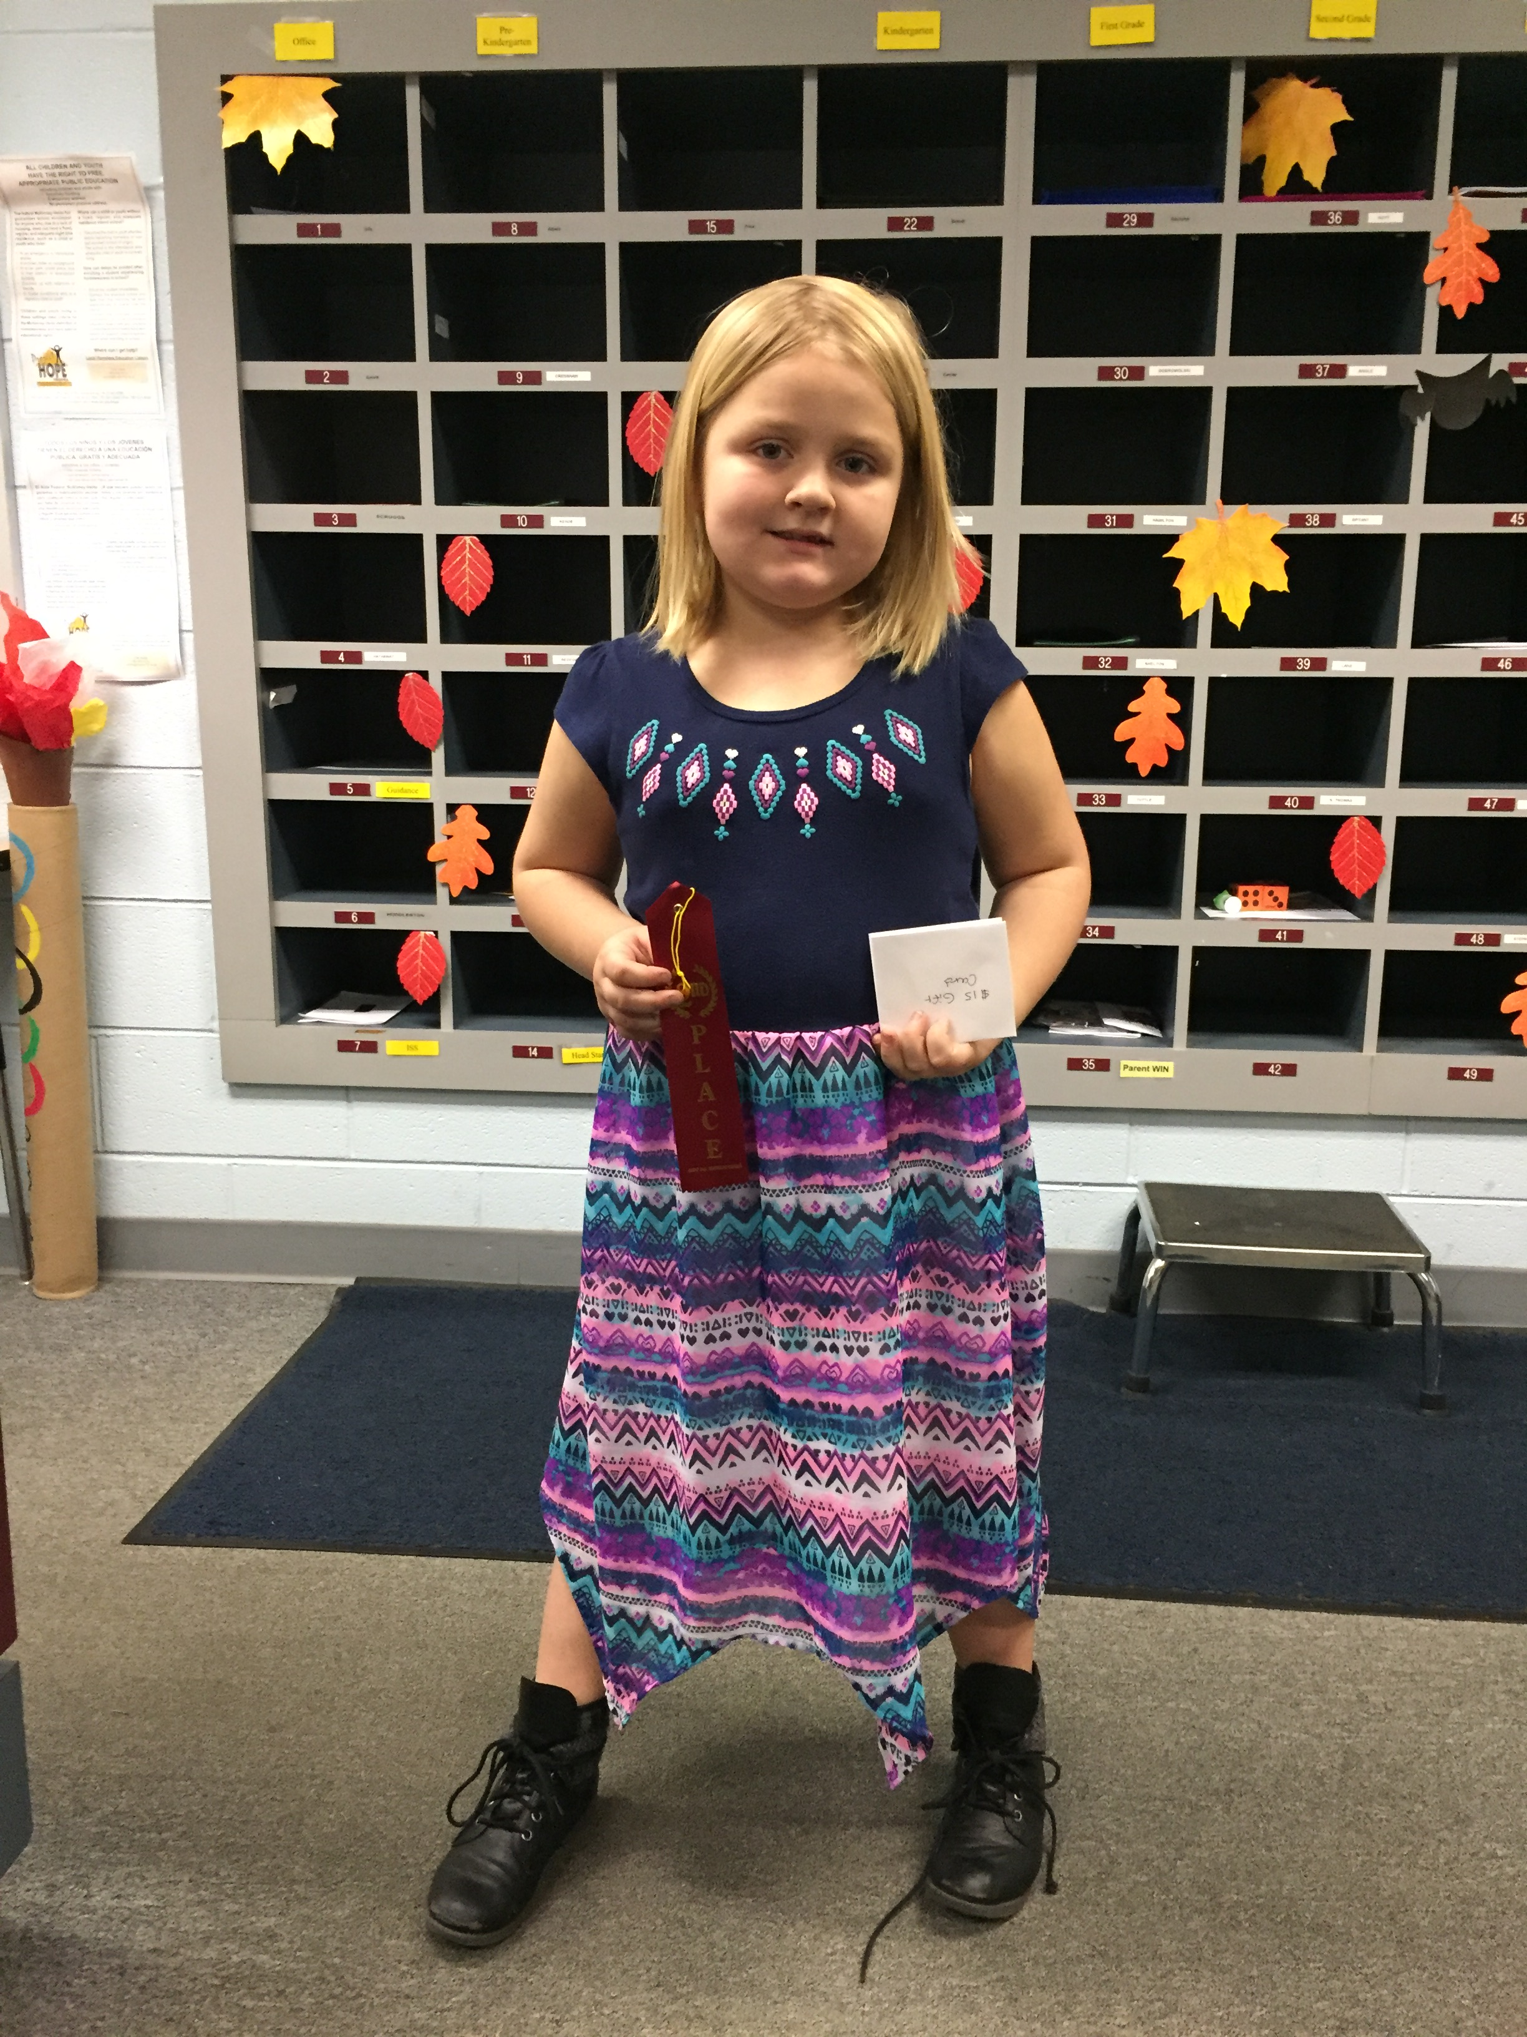
2016 Cumberland Poster Contest Winners
Katie Page Drew, Vanessa, Kaleb, Sammy, Mia and Mrs. Jones

Slide 28
Field Days
The District partners with State Parks, Game and Inland Fisheries, Forestry and Cooperative Extension to organize educational field days. Let us know if we can organize one for you.

Slide 29
Field Trips
The District has worked with the Chesapeake Bay Foundation to organize several field trips to the Brock Environmental Center in Virginia Beach.
Students tour the center and surrounding marshlands.
They board a 40-foot boat and explore the Lynnhaven River and Chesapeake Bay
They conduct water quality monitoring

Slide 30
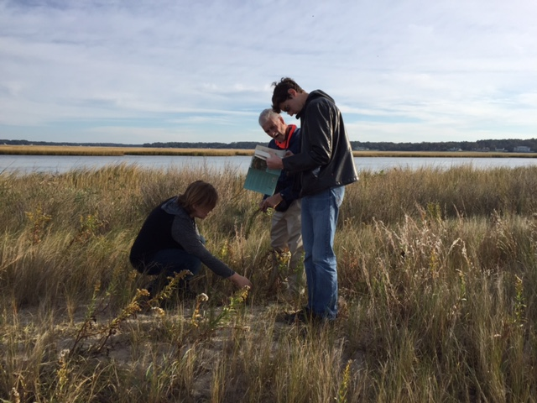
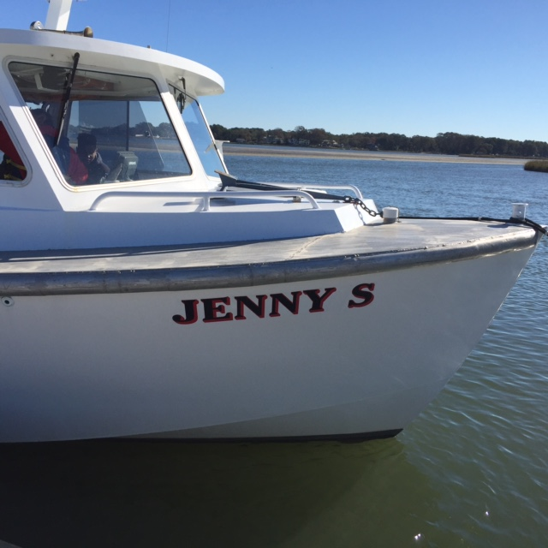
Field Trips
Trawl for fish, separate the catch and learn about it
Pull of crab pots
Pull up eel pots

Slide 31
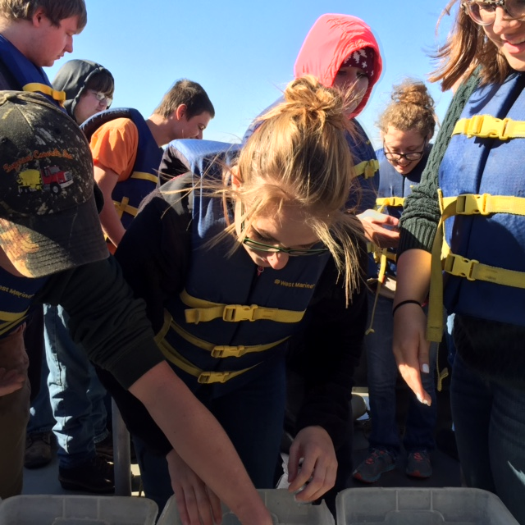
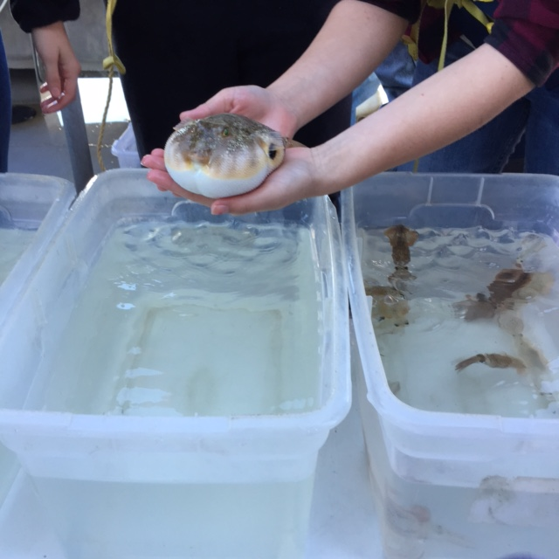
Field Trips

Slide 32
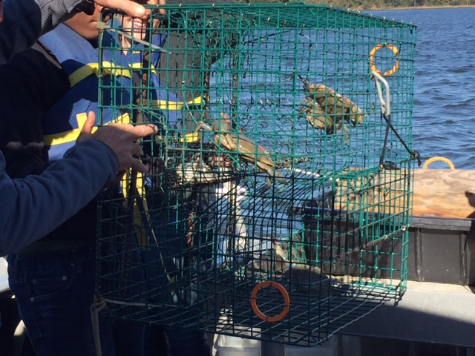
Field Trips

Slide 33
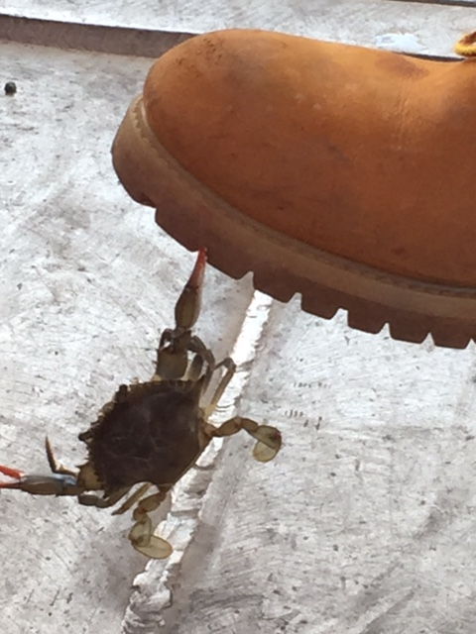
Field Trips

Slide 34
We can Tailor Make a Program Just for You
If your students just aren’t grasping a concept and you think we can create a program to help them grasp it, let us know. We are here to support you!

Slide 35
Resources Available for Check Out
The District has all kinds of resources available for check-out. From buckets, to trowels, to books, to actual program materials. Get your list of available resources today.

Slide 36
College Scholarships
District awards two $1,000 scholarships each year: one to a senior in Buckingham County and one to a senior in Cumberland County
Full-time student enrolled in or have applied to a college to study a curriculum related to environment
Application information available in January

Slide 37
Website
Be sure and visit our website at https://www.peterfranciscoswcd.org/

Slide 38
Envirothon

Slide 39
What is the Envirothon?
The Virginia Envirothon is a team based natural resources competition for high school students. Students learn stewardship and management concepts and work to solve real world environmental problems. The program is field-oriented, community based and gives students an opportunity to work with natural resource professionals.
Students work in teams of five. Throughout the school year students prepare to compete at the local level, qualify to then compete at the area level and the top three teams from the six Soil & Water Conservation District areas in the state compete to be the State Winner. These teams of high school students are tested on their knowledge of natural resources-soils, forestry, wildlife, aquatics and a current environmental issue.

Slide 40
Youth Conservation Camp

Slide 41
Youth Conservation Camp
For 40 years, the Virginia Association of Soil and Water Conservation Districts has sponsored a week long summer conservation camp for Virginia high school students (currently enrolled in grades 9-12) on the campus of Virginia Tech. The program brings together about 70 interested students for a week of learning about Virginia’s natural resources from conservation professionals and faculty from Virginia Tech. Most of the instruction is hands-on and outdoors.

Slide 42
Youth Conservation Camp
Peter Francisco SWCD sponsors at least two and up to four students for this camp. Below is a typical Youth Conservation Camp Week: Canoeing on the New River
Tour of Va. Tech Volleyball Tournament Claytor Lake State Park Trip
Lake Ecology Session Fisheries Management Water Quality Stream Morphology Session
Cascades Hike Tour Forest Products Center Turfgrass Management Session
Tour Dairy Science Center Tour Swine Center Tour College of Agriculture & Life Sciences
Soils Session Karst Session Tour Veterinary Teaching Hospital GPS Scavenger Hunt

