Slide 1

Peter Francisco Soil & Water Conservation District

Slide 2
What is a soil and water conservation district?
Soil and Water Conservation Districts were created during the Dust Bowl of the 1930's to solve soil and water conservation needs.
The Peter Francisco Soil and Water Conservation District (Peter Francisco SWCD) is a political subdivision of the Commonwealth of Virginia and is responsible under State Law for soil and water conservation work within the boundaries of Buckingham and Cumberland Counties. The District’s purpose is to encourage and initiate land use practices that help improve water quality and reduce soil erosion as well as educate the community in protecting our natural resources.

Slide 3
Why is it important to conserve soil and water?
All the water in the world demo
The Earth as an apple demo

Slide 4
SOL- Related Educational Programs for Elementary School
The District offers free programs and has compiled a list of programs by grade together with the SOL that the program addresses.
Each program has a hands-on component and is designed to make learning fun.
Here are a few of my favorites:

Slide 5
Frogs by the Bog and Leap Frog Relay
Students sit on a blue tarp and learn interesting facts about frogs and their life cycle. We read an entertaining book about a frog on a log in a bog.
Students can make a frog crown
And if time, they can play leap frog relay. Elements of this relay include tossing a bean bag in a bucket, hopping like a frog from lily pad to lily pad, walking a plank, weaving through cones, and jumping through a ring on a stand. Students learn to follow directions and develop their motor skills.
SOL: Science K.7, PE K.1, K.2, English K.3, Science 1.5, PE 1.1a,b and 1.5a, English 1.2c,

Slide 6
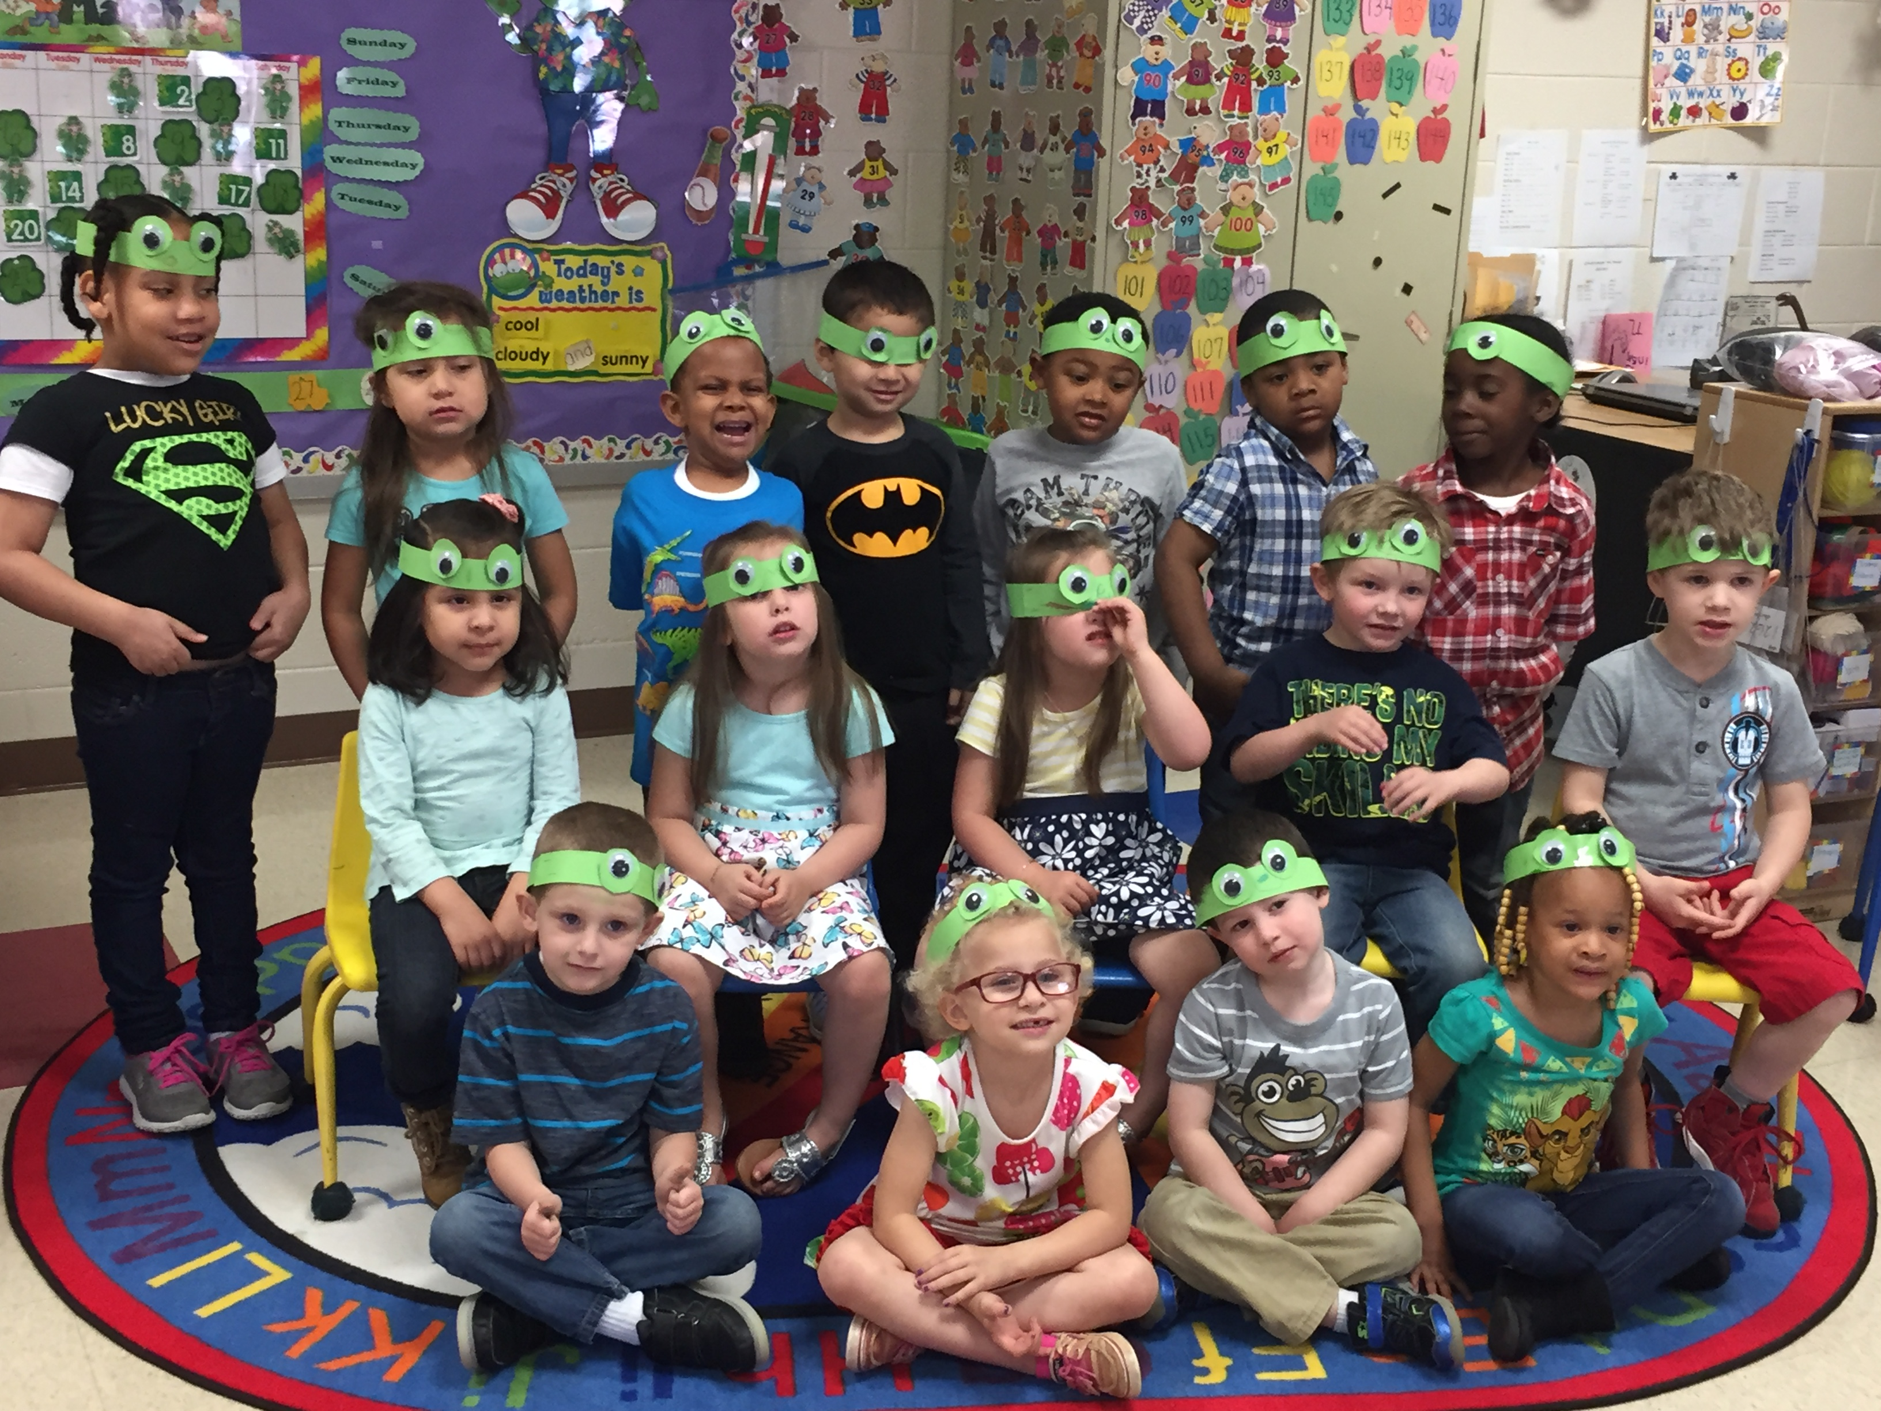
Frogs by the Bog

Slide 7
Litterless Lunch and Recycle Game
We dress in an Earth costume
Larry the Lunchbox is filled with reusable lunch box items to help students understand how they can reuse and recycle.
We dump a bin of trash in the middle of the floor and students take turns picking up an item and putting it in the appropriate recycle bin. They also come up with ideas about how the item can be reused.
This really helps the students grasp the concept of reduce, reuse and recycle.
SOL: Science K.11.b, 1.8c

Slide 8
Pollinators – Our Local Heroes
Students learn the basic parts of a plant and the role that bats, bees, beetles, butterflies, hummingbirds and flies play in producing food and plant reproduction.
We watch a Ted Talk Video about the Beauty of Pollination.
We play with puppets and look at the life cycle of a butterfly
1st grade students make a “na, na, na, na, na, bat mask and 4th grade students make a cootie catcher.
I have bat wings to show the students and we all laugh!
SOL Science 1.4, 1.5, 4.4

Slide 9
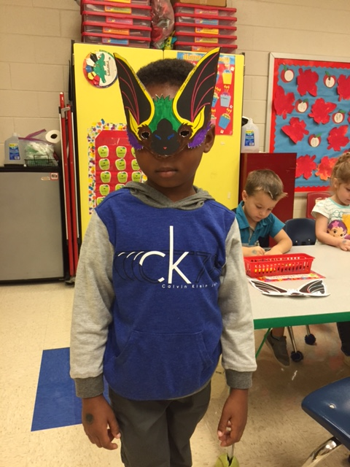
Pollinators

Slide 10
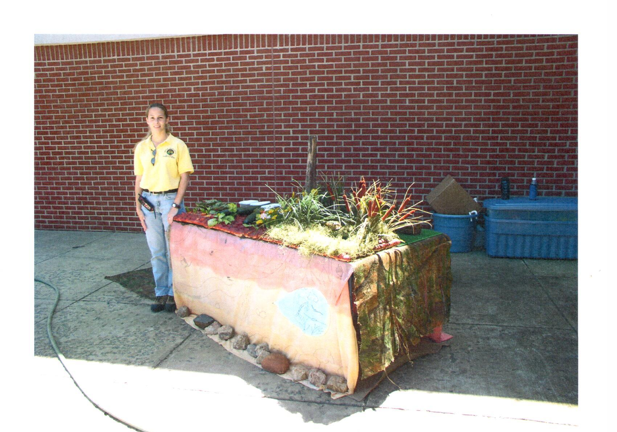
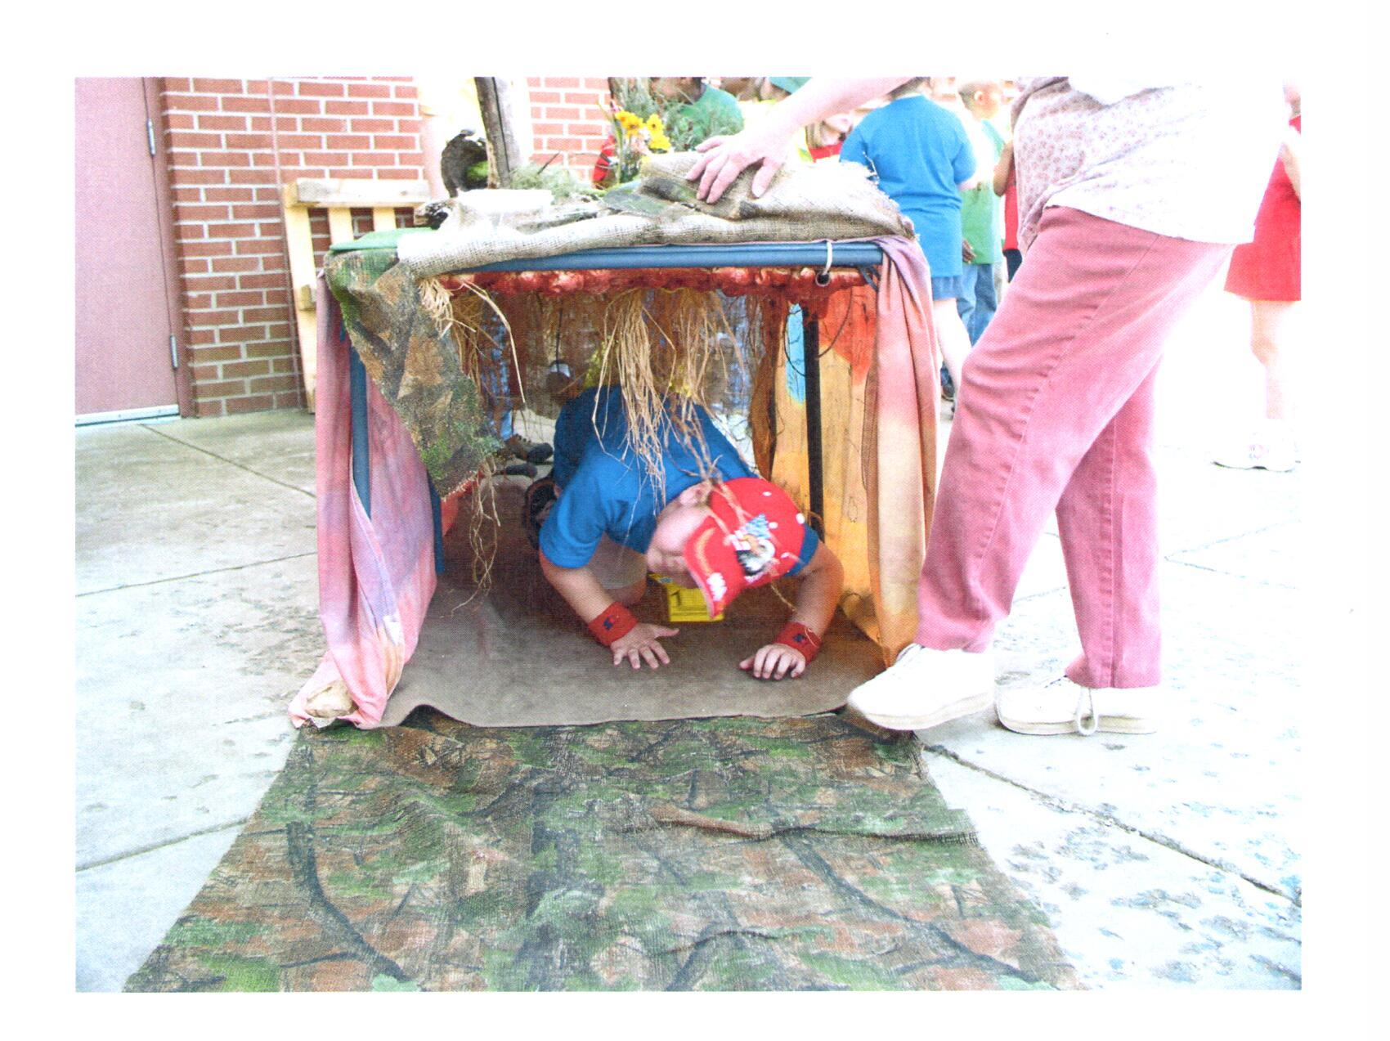
Soil Tunnel

Slide 11
Soil Tunnel/Soil Babies
Squirmin’ Herman tells about life under the ground as an earthworm and his contribution to healthy soil.
The tunnel gives students the ability to observe plant and animal life from two perspectives: above and below ground.
Students learn what plants need to grow and survive as they make their very own soil baby.

Slide 12
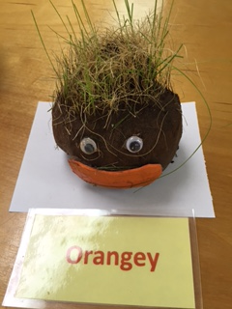
Soil Babies
To make a soil baby we use a knee-high stocking and put 2 spoons of grass seed in the toe. We add a couple scoops of soil and form the stocking into a ball. We tie off the end and cut the extra stocking off. Then we turn the ball upside down so the grass seed is on top and put eyes and a mouth on. We place it in a Styrofoam container. Students can put water in the container when they get home and place the soil baby where it gets sunlight. In about a week, their baby will grow hair!
SOL: Science K.1, K.7, K.9, K.10, 1.1b, 1.4a,b

Slide 13
Who Polluted the River?
This is an interactive story dramatizing how a water body becomes polluted as populations increase and resource use changes.
Freddie the fish, Tommy the Turtle and Sarah the Snake live in the James River. Their water starts out clean and then . . .
Students one by one add a container of pollutant into their water. It may be a container of soy sauce to represent an oil leak from their car that rain washed into the river, or a container with cocoa powder, water and toilet paper in it because a septic system failed and leached into the river.

Slide 14
Who Polluted the River? (continued)
By the end of the program, the critters in the water are no longer visible
Students learn that the consequences of their actions along with the consequences of others actions add up and each person was responsible for polluting the river.
SOL: Science K.1, K.5, K.10, K.11, 1.8b, 3.9)

Slide 15
Animal Tracks, Scat and Skulls
Students learn the characteristics of a mammal
Food chains/webs are discussed
They learn the differences in herbivores, carnivores and omnivores
Students learn how to tell if a mammal is an herbivore or carnivore/omnivore by the type of teeth they have
We talk about scat and how herbivores produce round balls and carnivores/omnivores lay “logs”
Students play a game where they have to scavenge for food and we add up the cards to see if they got enough food to survive. We give different scenarios—someone may be injured and have to hop on one foot, one may be collecting enough food to feed their 4 pups, etc.

Slide 16
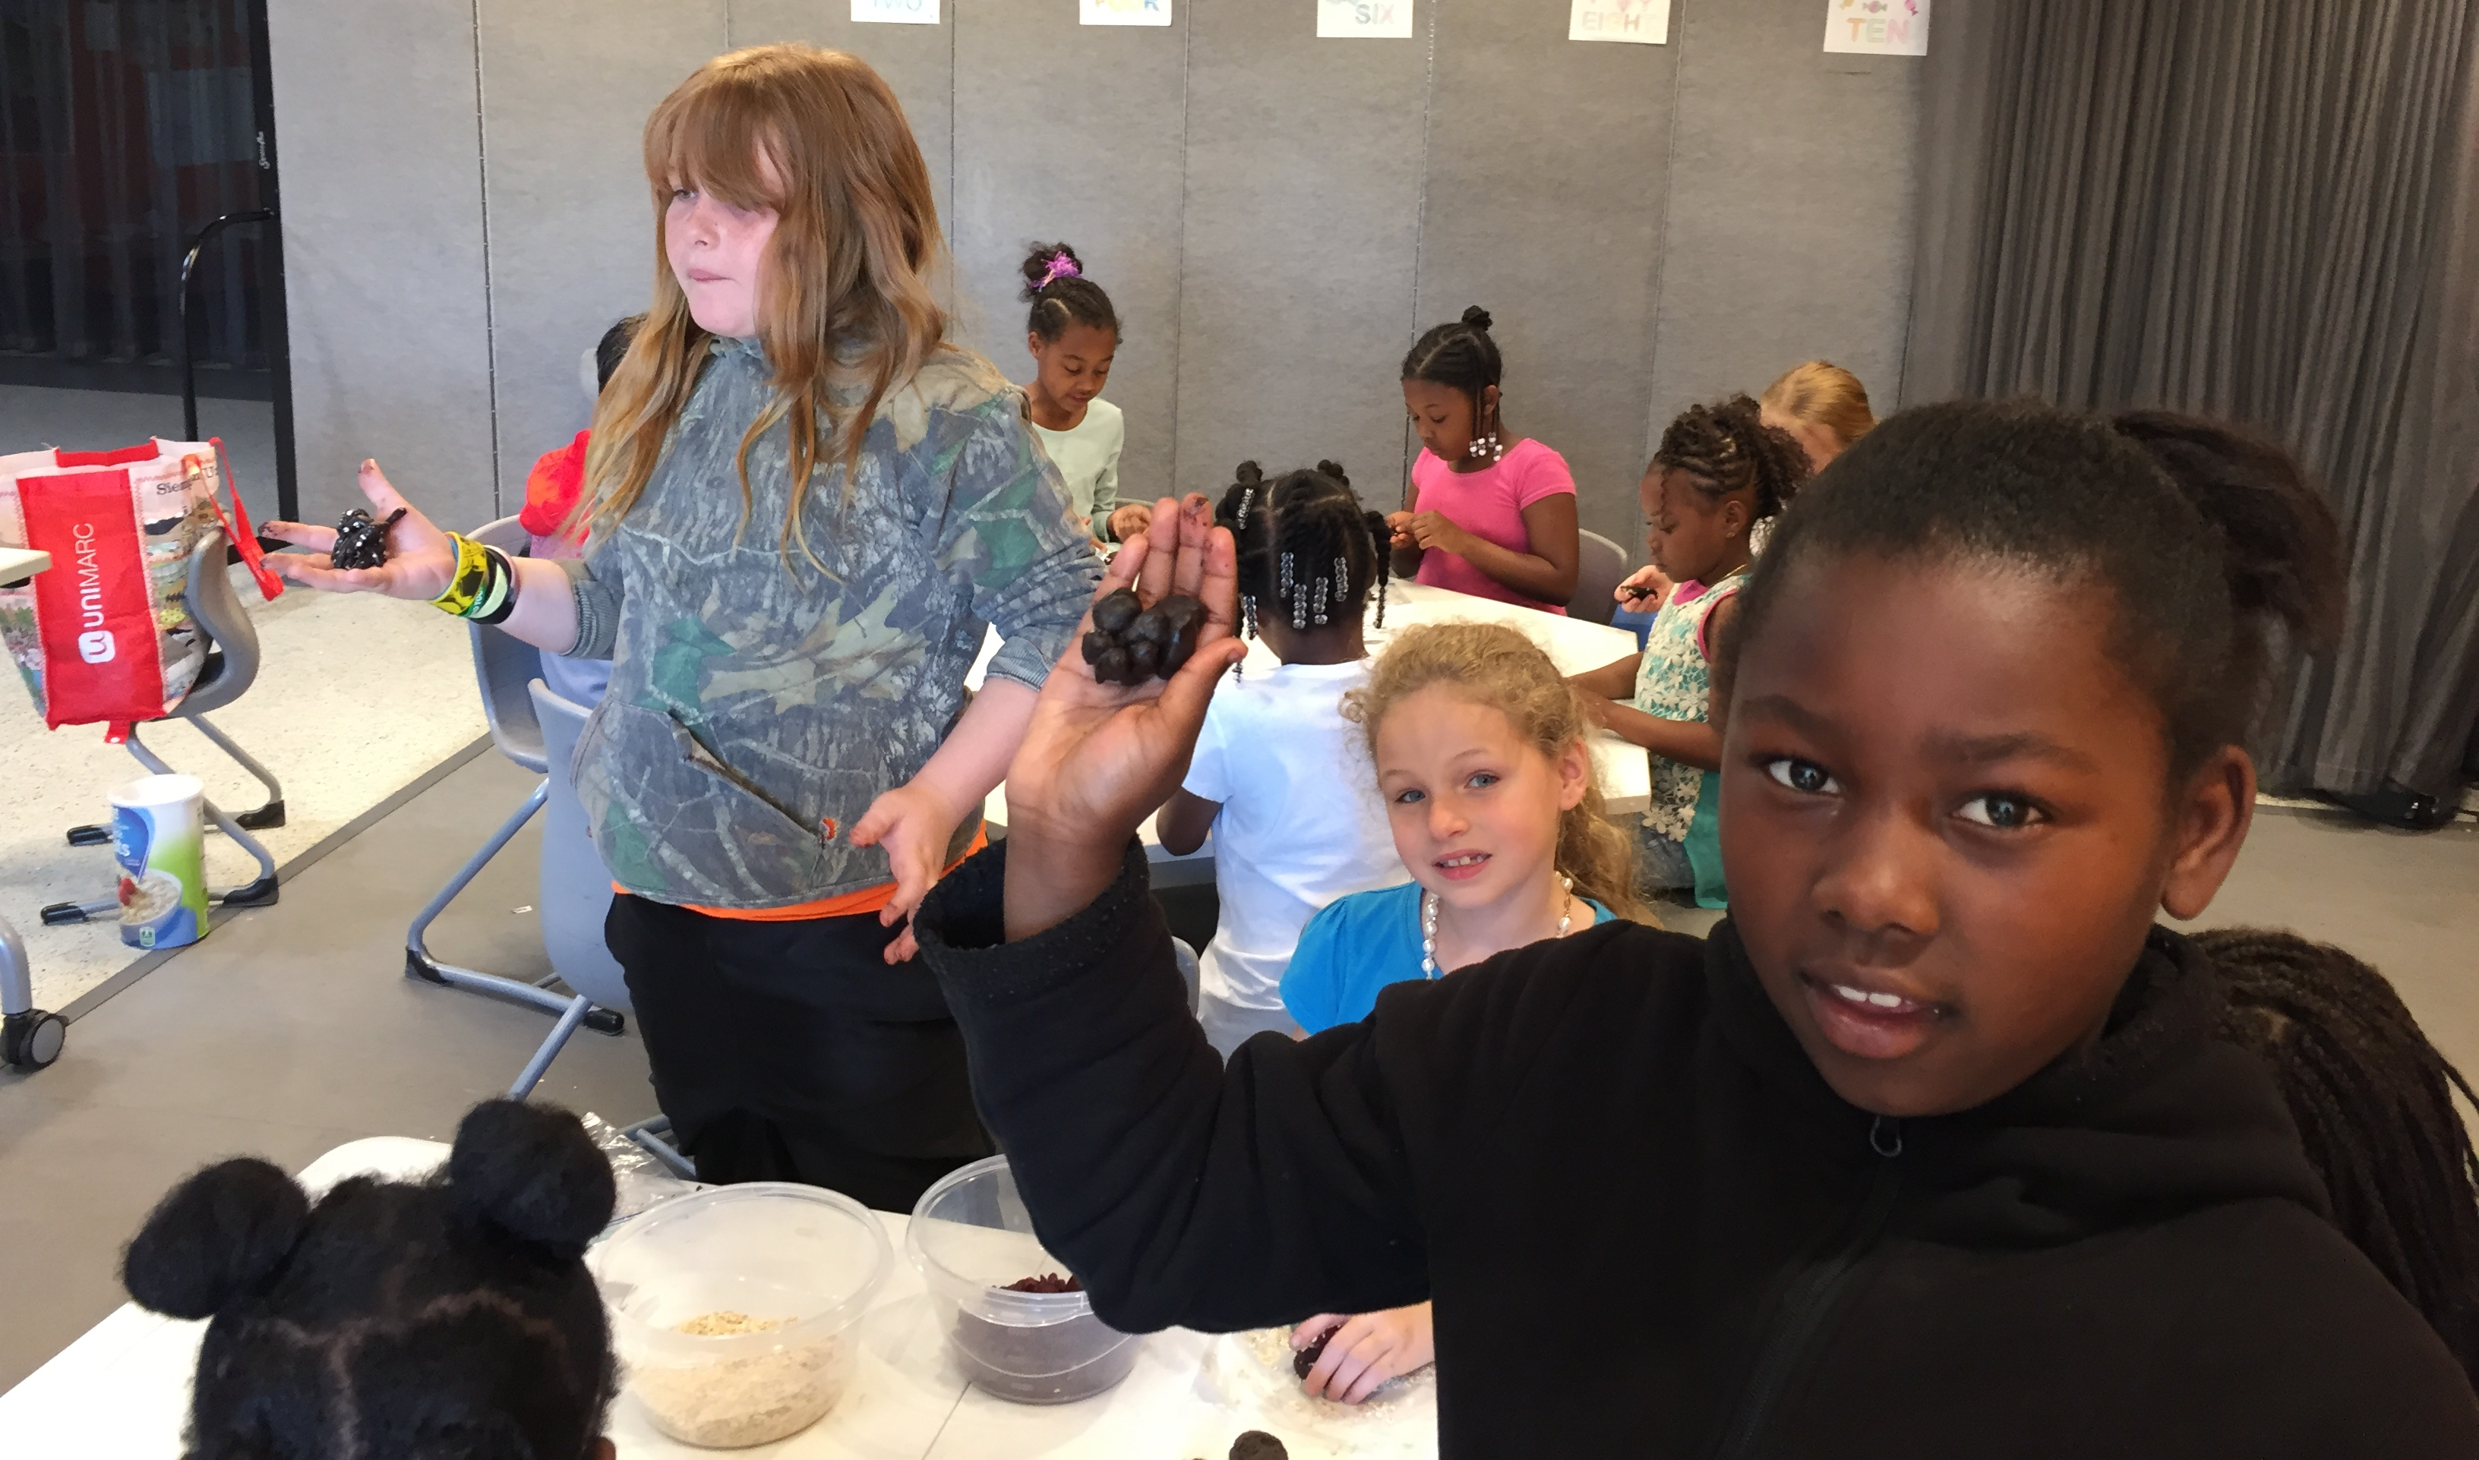
Animal Tracks, Scat and Skulls
Students then make their own edible scat.
SOL: Science 2.5, 3.4, 3.5, 3.6, 3.8

Slide 17
Soil Community Biorama
The biorama is displayed and students learn interesting facts about soil, plants, animals, insects and other organisms in the community and their dependency on each other. Life cycles of the insects are discussed as well.
Highlight the carion beetle.
SOL: Science 2.4, 2.5a, 3.7

Slide 18
We All Need Trees
Did you know trees tame storm water, provide shade, protect us from harsh winds, give us oxygen, save us energy, help mitigate soil erosion, help purify water, serve as wildlife habitat, are completely renewable and serve as a major industry for lumber, paper, and other natural products?
Through modern science, man has learned how to take the fiber from trees and create wonderful items that make our everyday lives better and more enjoyable. In fact, there are over 5,000 different products which come from trees. Many medicines, clothing, foods, cosmetics, paints, even some “plastics” are wood products.
So the next time you use a bowling ball, put on your new rayon dress, rinse with mouthwash, eat a cookie, or play your drums—THANK A TREE.

Slide 19
We All Need Trees
Students are amazed to see the displayed products that come from trees.
We read the “Giving Tree” and an interactive story about the number of tree products a boy uses from the time he wakes up until the time he catches the school bus.
We can do leaf rubbings from leaves collected in the school yard or by using our plastic leaf paltes.
SOL: Science 1.1, 1.7, 2.5, 2.7, 2.8c, 4.4

Slide 20
Intro to Water Cycle/Incredible Journey
Drippy the raindrop introduces students to the water cycle.
Students take on the role of a water molecule and visit different stations which simulate the paths that water takes in the water cycle.
A colored bead is collected at each station and students end up making a bracelet.
Thunderstorm in a cup demo
SOL: Science 3.9

Slide 21
Third Grade Soil Studies
This program makes a nice field day. We set up 5 15-minute stations. Each class has an hour and 15 minutes to rotate among the stations.
- Intro to soils (earth as an apple and amazing facts about soil)
- Soil particle size and pick a path relay
- Buried treasure
- Soil tunnel and S.K. Worm tells about soil
- Soil Shake and Erosion Experiments
SOL: Science 3.1 and 3.7

Slide 22
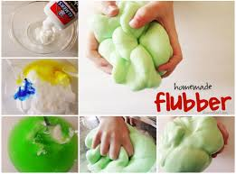
Icky Sticky Oooo
Students use recipe cards to make a their own goop, bouncy balls, play dough and flubber.
SOL: Science 3.3, 4.1, 5.4e

Slide 23
Rocks and Minerals – Rock Cycle
Fascinating facts about rocks and minerals are discussed. Students view trays of igneous, metamorphic and sedimentary rocks
Students divide into groups and are given a mineral and a test kit and have to identify their mineral.
Then students play a rock cycle game where they role a die to determine which of 11 stations they go to on their journey as a rock. At each station they collect a bead and end up making a bracelet.
SOL: Science 4.9c, Science 5.1, 5.7

Slide 24
Virginia’s Regions and Ag Products
A large, durable floor map of Virginia delineated by geographic regions is used along with about 20 items representing agricultural products produced in Virginia. Students are given a product and they tell about it as they stand on the map where the product is primarily produced.
We also have a Jeopardy-style game on Virginia’s geography which can be played.

Slide 25
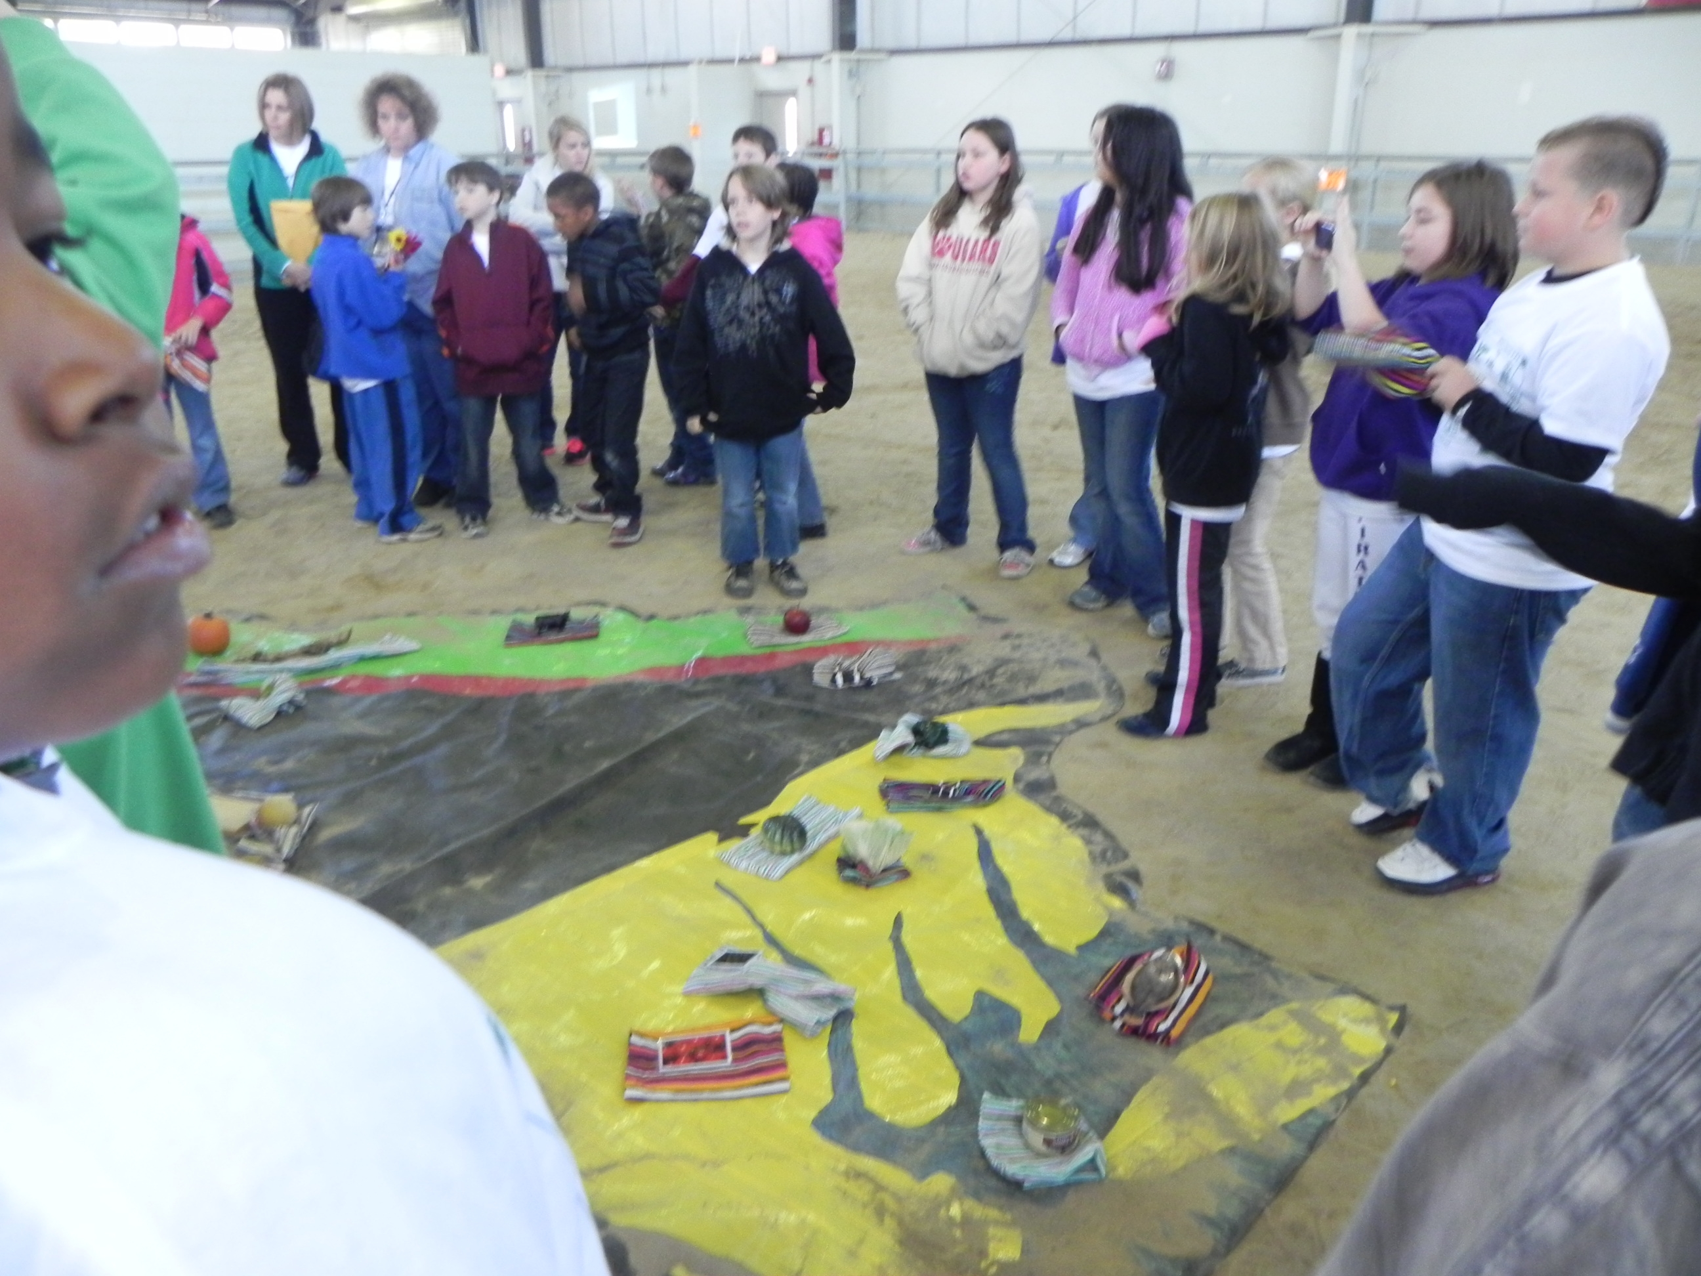
Virginia’s Regions and Ag Products
SOL: Science 4.9, VS.2b, VS.10b

Slide 26
What in the World is a Watershed?
Using a map of the county, students learn the watershed address for their school
The enviroscape, a portable 3-D Model provides a hands-on, interactive demonstration of the sources and effects of water pollution.
SOL: Science 4.9a

Slide 27
Poster Contest
Each year the National Association of Conservation District has a theme. The theme for 2017 is “Healthy Soils are Full of Life”
Did you know that in a handful of healthy soil, there are more living organisms than there are human beings on planet earth? Most of these organisms are bacteria which help keep soil’s pH in balance. We use soil bacteria to make antibiotics, anti-depressants, anti-fungal and anti-cancer medicines.

Slide 28
Poster Contest
There are 5 categories for the contest: K-1, 2-3, 4-6, 7-9 and 10-12
The District will award a $75 gift card to first place winners, $50 to second place winners and $25 for third place winners in each category.
Posters are due October 2, 2017
Healthy Soils are Full of Life must be written somewhere on the poster and an entry form must be attached to the back of the poster. (Hand out entry forms with rules on the back side)

Slide 29
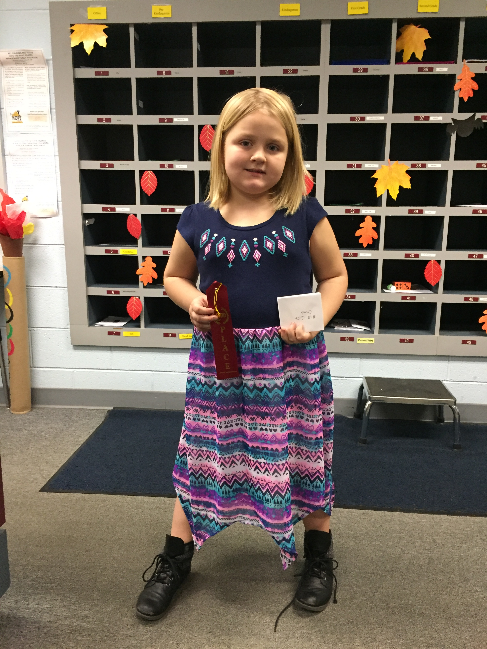
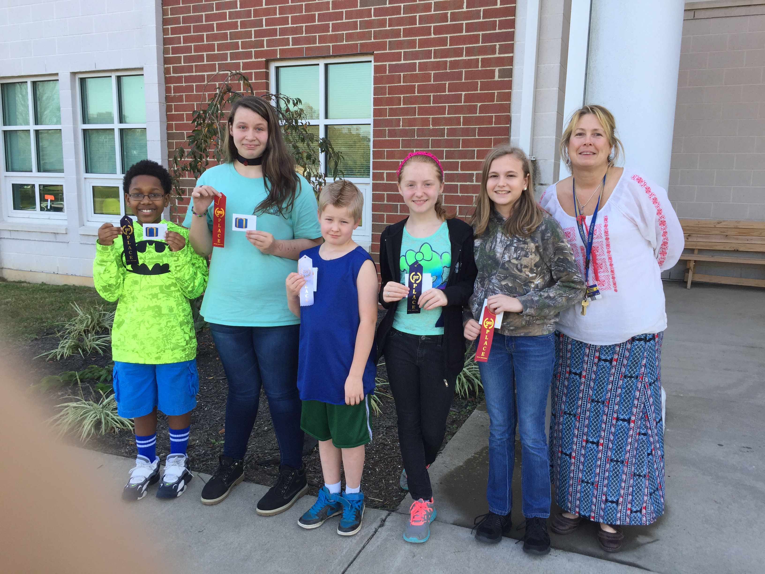
2016 Cumberland Poster Contest Winners
Katie Page Drew, Vanessa, Kaleb, Sammy, Mia and Mrs. Jones

Slide 30
Field Days
The District partners with State Parks, Game and Inland Fisheries, Forestry and Cooperative Extension to organize educational field days. Let us know if we can organize one for you.

Slide 31

We can Tailor Make a Program Just for You
If your students just aren’t grasping a concept and you think we can create a program to help them grasp it, let us know. We are here to support you!

Slide 32
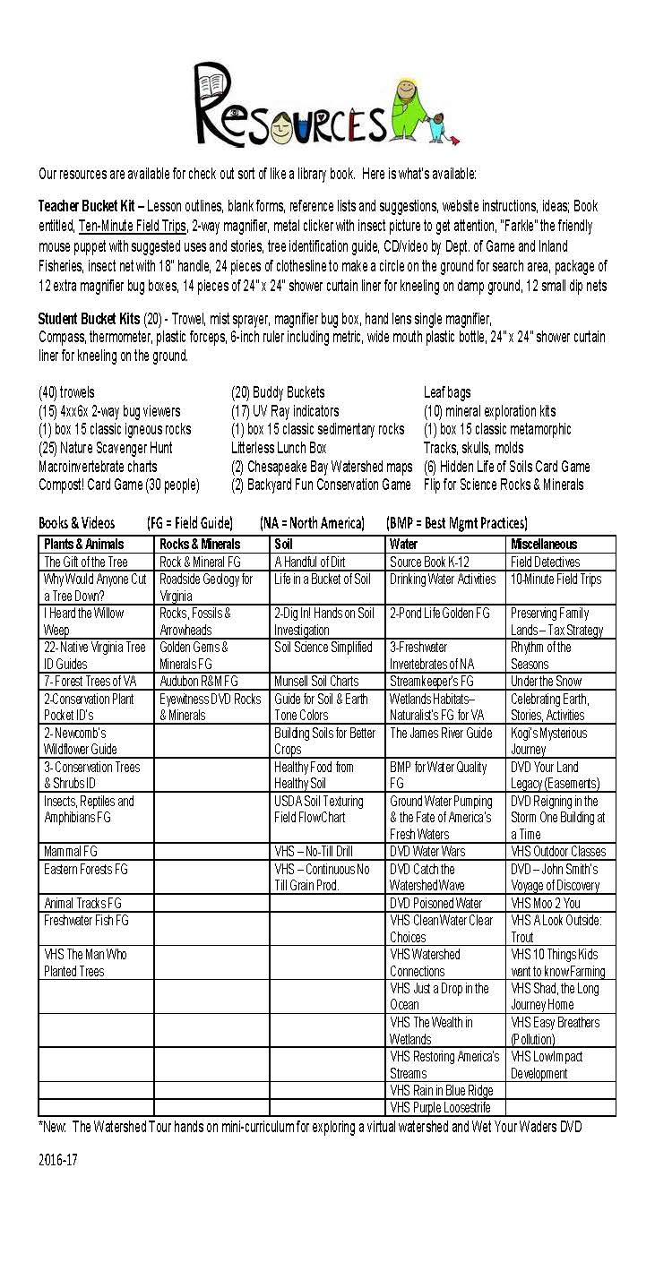
Resources Available for Check Out
The District has all kinds of resources available for check-out. From buckets, to trowels, to books, to actual program materials. Get your list of available resources today.

Slide 33
Website
Be sure and visit our website at https://www.peterfranciscoswcd.org/

